Slide 1
Hair, fibers, and paint

Slide 2
Bellringer
If the mother has type AA blood and the father has type AB, what are the possible blood types of their children?

Slide 3
Objective
Learn the three main parts of hair and how they can be used to identify the difference between human and animal hair.

Slide 4
Hair as evidence
Criminals do not intentionally leave hair evidence behind, and hair is not used to commit a crime (like a knife might be)
Hair is trace evidence
Left behind by the Locard Exchange Principle
There is always a cross transfer of evidence between suspect and victim or locale

Slide 5
Crime Scene Activity
On pages 106-108 in the textbook read about the crime scene.
Try to figure out who is guilty based on the evidence found at the crime scene.
Who done it?

Slide 6
Introduction to Hair
Before you can analyze hair as evidence you must understand its form or morphology.
Each person has about 5 million hairs on their body.
Most are extremely fine and hard to see

Slide 7
Introduction to Hair
Blondes have the most hair on their heads
120,000 hairs on their head
Redheads have the least hair on their heads
80,000 hairs on their head
Brown and Black haired people have about 100,000 hairs on their head.
Hairs are continuously shed. About 100 every 24 hour period.
Very easy to exchange hair with someone that is trying to murder you.

Slide 8
What hair is made of
Hair is made of complex cross-linked protein polymers (a molecule consisting of many identical repeating units)
These polymers are very resistant to breaking down.
Hair grows from a tubelike organ in the sublayer of skin called a hair follicle.

Slide 9
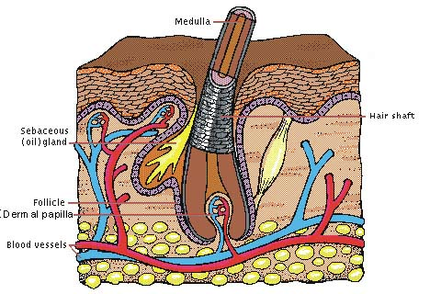
What hair is made of
The hairs root is embedded in the follicle
The follicle is linked to the body’s blood supply
What we just call hairs is actually called the hair shaft.

Slide 10
What is in your hair?
Hair continuously grows so traces of things your body takes in stays in your hair.
This is why they may take hair samples for drug tests and poisons.
This is also why a healthier diet is the best way to get nice hair, not shampoo and conditioner.

Slide 11
The Hair Shaft – 3 Parts
The Cuticle
Tough, clear outside covering of the hair shaft
The Cortex
Middle layer of the hair shaft that provides strength; comprises most of the hair mass
The Medulla
The spongy interior core of hair that gives it flexibility; appears as a canal in the middle of the shaft.

Slide 12
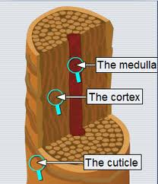
Hair Shaft Diagram

Slide 13
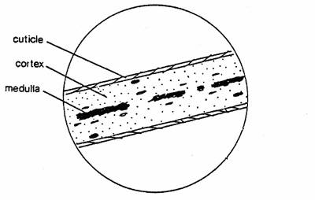
Hair Shaft Diagram

Slide 14
The Cuticle
It is made up of tough overlapping scales, like a fish or shingles
Humans have a much finer pattern of scales than animals have, and the scales don’t show much variation.
Differences in the cuticles of animal hairs can be used to identify species.

Slide 15
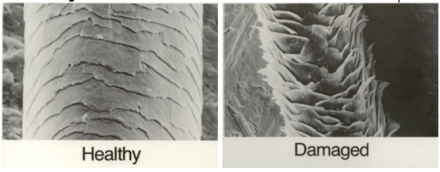
Cuticle Samples

Slide 16
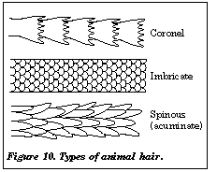
Cuticle Samples
Mouse
Human
Cat

Slide 17
Case Study
On page 121 of the textbook read the case study about Colin Ross
Do you think he should have been sentenced to death?
With the little you know about hair already why do you think the court over turned the ruling?

Slide 18
Summary
Which of the three main parts of the hair shaft can be used to identify whether or not a piece of hair is human or animal?

Slide 19
Bellringer
How can the hair’s cuticle tell you whether or not the hair is human or not?

Slide 20
Objectives
Learn how forensic scientists use the cortex, the medulla, and the shape of hair to help identify it and figure out who or what it came from.

Slide 21
The cortex
The cortex is made up of keratin molecules
These are the tough protein polymer made up of about 20 different amino acids
The cross-linking bonds make hair so resistant to chemical and biological degradation.
The sulfur in keratin also accounts for the distinctive smell of burning hair

Slide 22
The cortex
The cortex is the pigment that makes hair black, brown, yellow, or red.
The absence of pigment makes hair gray or white.
Dying hair is a complicated process

Slide 23
Changing your hair color
Can changing your natural hair color keep you from getting caught?
Nope
It is a multi-step process, but can be shortened
Ammonia is usually used to burn away the cuticle of your hair
Peroxide is then used to breaks down and remove your original color (sulfur is released)
Different chemicals or natural colors are added to replace the ones the peroxide removed

Slide 24
The medulla
The medulla is a row of cells like a canal running along the center of the cortex.
It may appear dark or translucent depending on whether there is air, liquid, or pigment within it.
It can be continuous, interrupted, or in pieces (fragmented)

Slide 25
Medulla Samples

Slide 26
Different Medulla
Human hairs generally have no medulla or one that is fragmented.
Except for Native Americans and Asians, who usually have continuous medulla
Animal hairs show a wide variety of medullar patterns.
Investigators can use these patterns to identify some species

Slide 27
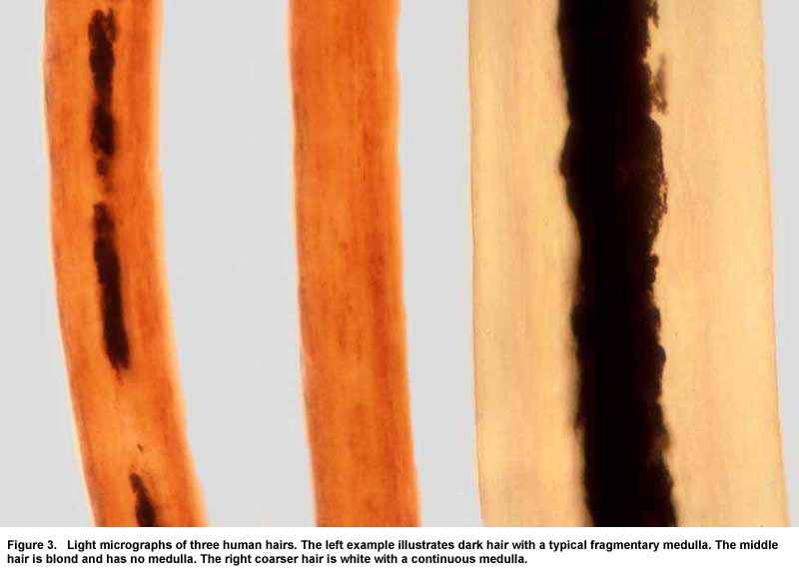
Identify these three medulla?

Slide 28
Hair Shape
Not every piece of hair has the same shape.
It is risky to assign racial characteristics to hair evidence, but generally,
Asians’ and Native Americans’ hair has a round cross section no twisting (straight)
European whites, Mexicans, and people of Middle Eastern background show an oval cross section, rarely a twist (curly)

Slide 29
Hair Shape
People of African heritage have hair characteristics that include a flat to crescent-shaped cross section with a twist
Oddly beard hair is often coarse and triangular in cross section.

Slide 30
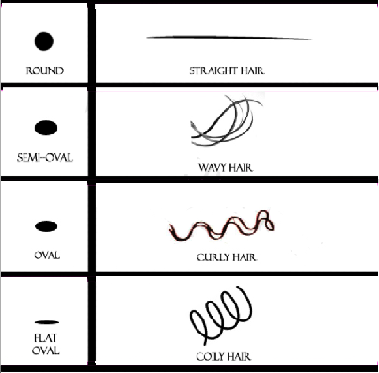
Hair shape examples

Slide 31
Case Study
On page 121 of the textbook read the case study about Colin Ross
Do you think he should have been sentenced to death?
With the little you know about hair already why do you think the court over turned the ruling?

Slide 32
Summary
How can each of the three main parts of the hair shaft (cuticle, cortex, and medulla) be used to identify whether or not a piece of hair is human or animal?

Slide 33
Bellringer
What are the three parts of hair shafts?

Slide 34
Objectives
Learn how the roots and tips of hair can be used to match a hair sample with a suspect.
Test your knowledge of hair forensics.

Slide 35
NEOTWY’s
Who would like to share their NEOTWY from this week?
Please pass up your NEOTWY’s
That was your final grade for this semester.
If you have any late assignments to hand in to me, do it before I leave here today.

Slide 36
The Roots
The root can also be important in classifying hair
The root of the hair is under the skin (like the roots of plants)
The shape of a removed root depends on the stage that the hair sample is in

Slide 37
Hair’s 3 Stages
Anagen Phase:
Period of growth in the hair cycle, averaging three to five years
Catagen Phase:
Intermediate period of hair growth, lasting about three weeks
Telogen Phase:
Final phase in hair growth, resulting in the loss of hair over about three months.

Slide 38
Hair’s 3 Phases
About 80 to 90 percent is in the anagen phase at any given time.
Most of your hair is in the healthy growing stage.
Hair does not grow forever. It only has about 3.5 to 6 years to grow before it falls out naturally.
The shape of the root changes with the age of the piece of hair.

Slide 39
Root Shapes
When hair is ready to fall out the root is a bulb shape.
If you brush your hair with a comb, most of the hairs will have a bulb shape at the bottom
If a piece of hair is forcefully removed it could still have follicle tissue attached to it.
This is why getting your hair ripped out hurts.

Slide 40
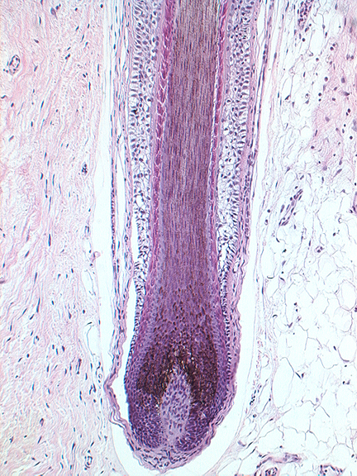
Close up of a hair root

Slide 41
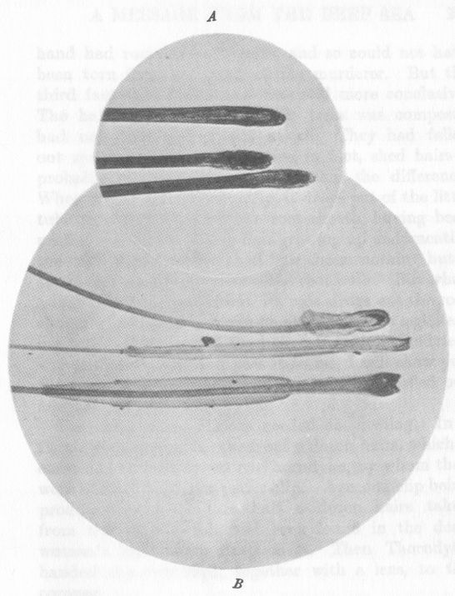
Examples
Fell out
Torn out
What’s the difference?

Slide 42
Animal Roots
Like the other characteristics we looked at, roots can also tell you whether or not the hair is human or animal.
Human hair roots are bulb shaped
In general animal hair roots are spear-shaped
Cat hair roots are often frayed at the base
Dog roots are often spade-shaped

Slide 43
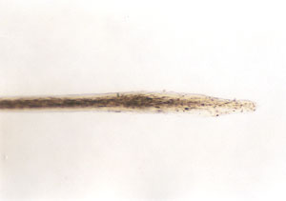
Animal Hair Root

Slide 44
Hair Tips
Uncut hair will taper to a point
If it was recently cut it will square at the end
About two or three weeks after a cut hair will round off
How can this help detectives who found a human hair sample with square ends?

Slide 45
Pencil Analogy
The paint of pencil is the cuticle
The non painted part is the cortex
The graphite is the medulla
The metal part is the beginning of the hair follicle
The eraser is the root

Slide 46
Hair Summary
On pages 118 to 199 of your textbook read the section “Back at the Scene of the Crime”
Take notes on the parts you believe to be important.
Then answer questions #2, 3, 4, 6, 7, 8, 9, 10, 11, 12, 13, 14, 15, 16, 17, 18, 20
Answer on a separate sheet of paper, and turn in when you’re done.

