Slide 1
Dynamics and Statics

Slide 2
Bellringer
What is the resultant velocity vector on a go kart that is traveling at 10 m/s north and is being blow by the wind 0.5m/s east?
Include the magnitude and angle.

Slide 3
Objectives
Learn more vocabulary that will help you solve dynamics and statics problems
Practice dynamics and statics problems

Slide 4
Some words
Dynamics:
The study of forces and motion
Statics:
The study of forces in static equilibrium

Slide 5
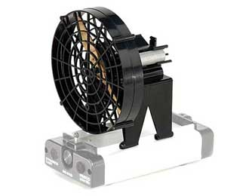
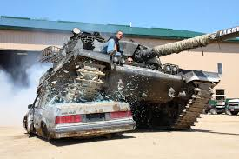
More words
Static:
Not moving.
Equilibrium:
The condition of a system in which all competing influences are balanced (Net Force = 0)

Slide 6
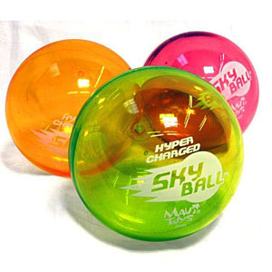
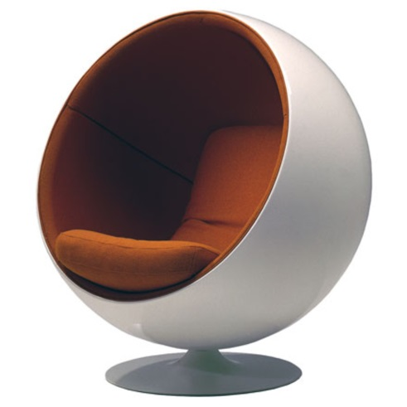
Even more words
System:
A set of interacting or interdependent pieces forming one thing.
Net Force:
The overall force acting on a system (all the forces added together)

Slide 7
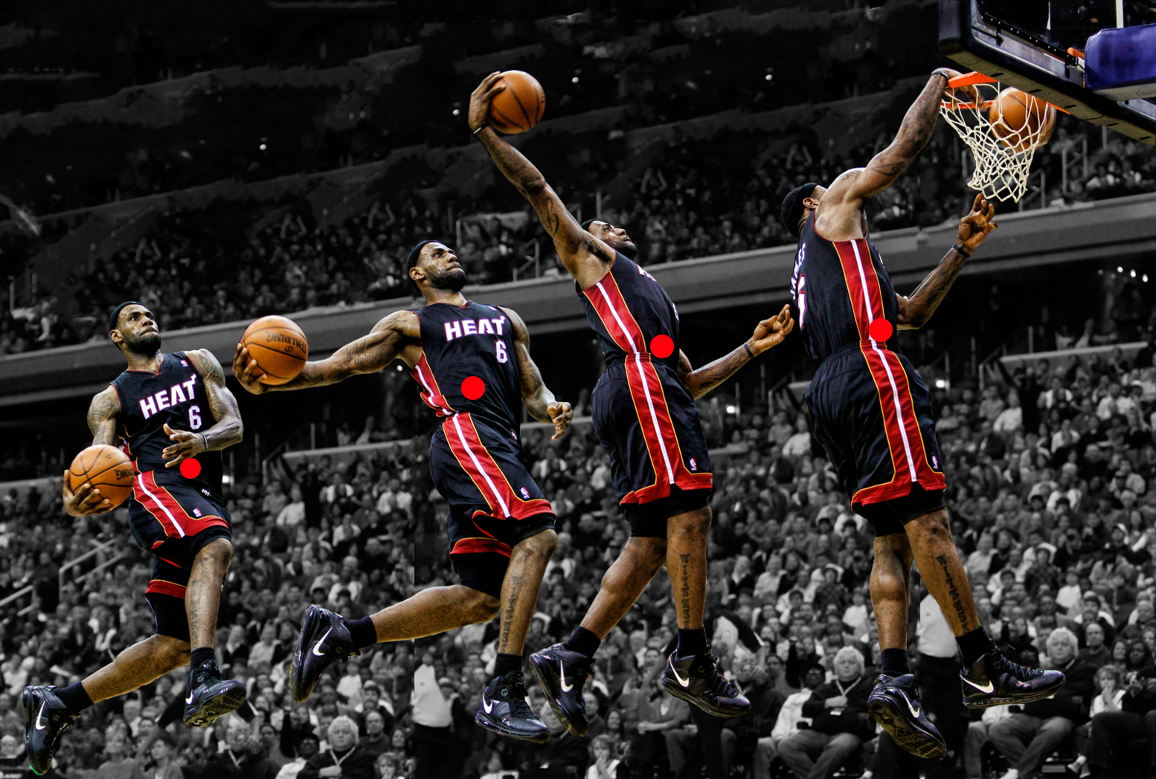
Center of Mass

Slide 8
CFU
If an object is moving at constant velocity is it in static equilibrium?
What is the net force on an object that is moving at constant velocity?

Slide 9
More CFU
If an object is moving at constant velocity is it at equilibrium?
If there is a non-zero net force on a system can it be moving at constant velocity?

Slide 10
Define all objects in each system.
Baseball in the catcher’s mitt.
Your dinner on a table.

Slide 11
Free-Body Diagrams
Baseball in the catcher’s mitt.
Your dinner on a table.

Slide 12
Practice
For each of the following situations, specify the system and draw a free-body diagram. Label all forces, and indicate the direction of the acceleration and of the net force.
A skydiver falls downward through the air at constant velocity. (The air exerts an upward force on the person.)
You hold a softball in your hand and move it up.
Two people pushing equally on a table in opposite directions.
Two equally strong huskies pulling a sled.

Slide 13
Force and mass
Demo

Slide 14
Happy Huskies
Two identical huskies are pulling a sled through the snow. They are each pulling with a force of 40 N in the same direction. Neglecting friction (snow) what is the total net force on the sled?

Slide 15
Hateful Huskies
Two identical huskies are pulling a sled through the snow. They are each pulling with a force of 40 N in the opposite direction. Neglecting friction (snow) what is the total net force on the sled?

Slide 16
Hungry Huskies
Two identical huskies are pulling a sled through the snow. They are each pulling with a force of 40 N at an angle of 90 degrees from one another. Neglecting friction (snow) what is the total net force on the sled?

Slide 17
Humble Huskies
What have our little husky buddies taught us?
What is the maximum resultant of two forces and the angle between them?
What is the minimum resultant of two forces and the angle between them?

Slide 18
Concurrent Forces
Concurrent Forces are the Regent’s exams fancy way of saying forces that act on a system at the same time.

Slide 19
Concurrent Forces Examples
Which pair of concurrent forces may have a resultant of 40 N?
1N and 5N
20N and 10N
20N and 30N
50N and 5N
Which pair of concurrent forces may have a resultant of 20 N?
5N and 10N
20N and 20N
20N and 50N
30N and 5N

Slide 20
Concurrent Forces Examples
Two concurrent force of 50N and X Newtons have a resultant of 100N. Force X could be
10N
40N
90N
160N
Two concurrent force of 40N and X Newtons have a resultant of 100N. Force X could be
20N
40N
80N
150N

Slide 21
Concurrent Forces Examples
The resultant of two concurrent forces is minimum when the angle between them is
0 degrees
45 degrees
90 degrees
180 degrees
As the angle between two concurrent forces is increased from 10 to 75 degrees, the magnitude of the resultant force
decreases
increases
Remains the same

Slide 22
Pillow Fight!
Mary is holding a pillow with a mass of 0.3kg when Sarah decides that she wants it and tries to pull it away from Mary. Is Sarah pulls horizontally on the pillow with a force of 10N and Mary pulls with a horizontal force of 11N, what is the horizontal acceleration of the pillow?

Slide 23
Pillow Fight
First identify the system and what is acting on it:

Slide 24
Pillow Fight
Then draw a free body diagram:

Slide 25
Pillow Fight
Then solve for the unknown:

Slide 26
Pillow Fight
Finally; as always, evaluate the answer:

Slide 27
Ice Skating
Buddy is learning how to ice skate. He wants his momma to pull him along so that he has an acceleration of 0.8m/s^2. If Buddy’s mass is 27.2kg, with what force does his momma need to pull him? (Neglect any resistance between the ice and Buddy’s skates.)
Use the same steps as the pillow fight problem.

Slide 28
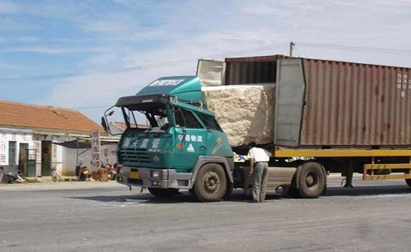
Pop quiz
Use inertia and Newton’s first law of motion to explain this picture. (Write your response)

Slide 29
Newton’s First Law
Car crash demo

Slide 30
What is weight?
An object’s weight is the gravitational force experienced by that object.
Weight = Mass x Gravitational Field
Gravitational Field on Earth is 9.81m/s^2
So this is the same equation as F=ma

Slide 31
Scales
How do scales find your weight?????????
Scales are not accelerating so the net force on them must be zero.
The scale pushes up with the same force that gravity pushes you down.
This action reaction pair causes calibrated springs to stretch and turn a dial that displays your weight.

Slide 32
Comparing weights
Kiran holds a golden puppy in each hand. Puppy A has a mass of 4kg and puppy B has a mass of 12kg. What upward forces do his two hands exert to keep the puppies at rest?
If he then drops the two puppies, with what acceleration do they fall? (Ignoring air resistance.)

Slide 33
Changing mass
Does an objects mass change depending on what gravitational field it is in?
Does an objects weight change depending on what gravitational field it is in?

Slide 34
Changing Weight
If you have a mass of 72kg what is your weight in Newtons of Earth?
What is the weight in Newtons on the moon? (The acceleration due to gravity there is 1.62m/s^2)
So what’s the easiest way to lose some weight??
What is the weight in Newtons on Jupiter? (The acceleration due to gravity there is 24.79m/s^s)

Slide 35
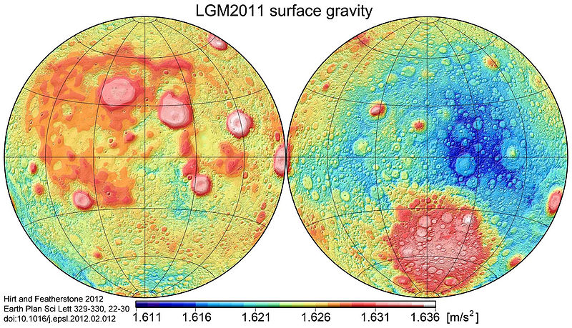
Gravity map of the Moon

Slide 36
Weight Training
What is the gravitational acceleration on a planet where a 4kg mass has a weight of 16N on the planet’s surface?
What is the gravitational acceleration on a planet where a 2kg mass has a weight of 8N on the planet’s surface?

Slide 37
Weight Training
If your weight on Earth is 500N, what is your weight on a planet where the acceleration due to gravity is 6m/s^2

Slide 38
Weightlessness
It is impossible to be massless, but is it impossible to be weightless??
No you always have a weight too.
Sometimes it just doesn’t seem like you do.
This is called apparent weightlessness.

Slide 39
Apparent Weightlessness
Apparent Weightlessness means that there are no contact forces acting to support the object, and the object’s apparent weight is zero.
What are contact forces?
Any forces that need to be in contact with an object to exert a force on it.
The feeling of weightlessness is most common when you or an object is in free-fall.

Slide 40
Examples
Big drops on rollercoasters
Dips in airplanes
Orbiting the Earth
Going down a big hill
Falling

Slide 41
Bellringer
Can an object be weightless?
Give an example

Slide 42
Objectives
Practice problems about apparent weightlessness
Learn about tension force and understand demos
Begin Lab #6

Slide 43
Elevator
Like most Americans you weight yourself on a bathroom scale in an elevator.
If you have a mass of 75kg, what will the scale read if the elevator is stationary?
735N

Slide 44
Elevator
What will the scale read if the elevator is moving at a constant velocity of 3m/s?
735N

Slide 45
Elevator
If the elevator accelerates upward at 2 m/s^2 for 2 seconds what does the scale read during the 2 seconds of acceleration?
885N

Slide 46
Elevator
If the elevator accelerates downward at 2 m/s^2 for 2 seconds what does the scale read during the 2 seconds of acceleration?
585N

Slide 47
Homework
Review sheet

Slide 48
Tension Force
What is tension??
Tension is simply a specific name for the force that s string or rope exerts!!
How many tensions can one rope have?

Slide 49
Tension
Do tension forces push or pull? How do you know?

Slide 50
Tension and pulleys
Demos
Nails and scales demo

Slide 51
Tension Examples
You have a heavy crate of standard sized envelopes that has a mass of 50kg. You decide the easiest way to move it is to pull it with a rope. If you put an acceleration on the box of 2.5m/s^2 what is the tension in the rope. (ignore friction)
Two people are playing tug of war. If they each pull the rope with 50N force in opposite directions what is the tension in the rope?

Slide 52
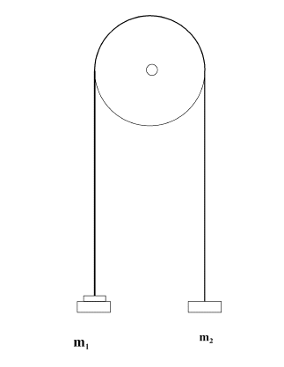
Tension examples
If two 5kg masses hang from opposite sides of a rope around a pulley what is the tension force in the rope?

Slide 53
Tension Example
A 50kg bucket is being lifted by a rope. The rope will not break if the tension is 525N or less. The bucket is accelerated up at 1.5m/s^2. Is the rope in danger of breaking?

Slide 54
Tension Example
Three blocks are each connected by a separate string, and are pulled along a frictionless surface. Box A is 4kg, box B is 2kg, and box c is 6 kg.
If F is 36N what is the acceleration of each box?
What are the tension forces in each of the strings? (Hint: Draw a separate free-body diagram for each block)

Slide 55
Homework

Slide 56
Skydiving
Why do skydivers have a terminal velocity?
Why do they need a parachute?

Slide 57
Practice
What is a 80kg skydiver’s drag force if his net acceleration is -2m/s^2.
Draw a free-body diagram of all the forces acting on the skydiver.
Solve for the missing forces.

Slide 58
Practice
What is a 70kg skydiver’s drag force if his net acceleration is -0.5m/s^2.
Draw a free-body diagram of all the forces acting on the skydiver.
Solve for the missing forces.

Slide 59
Maximum Drag Force
What is the strongest drag force a 65kg person could have?
What is the minimum acceleration a skydiver could have?
How does your velocity change the drag force?
How does air density change the drag force?

Slide 60
Questions – 1 minute
What is the drag force on a 76kg individual that is free-falling and has no acceleration?
What is the drag force of a 100kg food supply crate that is falling with zero net force?

Slide 61
Red Bull gives you wings
http://www.youtube.com/watch?v=raiFrxbHxV0

Slide 62
Back To Tension
Find the tension force between two 1kg boxes. The box on the left is being pulled with a force of 50N and the box on the right is being pulled with a force of 80N.
Draw a free body diagram.
Define the system you want to study.
Solve for the missing forces.

Slide 63
Tension Problems
When solving tension problems always start by looking at a system with the most known variables.
Remember if objects or different parts of the system are physically connected they must have the same acceleration.

Slide 64
Tension Example
Three blocks are each connected by separate strings, and are pulled along a frictionless surface. Box A is 4kg, box B is 2kg, and box c is 6 kg.
If F is 36N what is the acceleration of each box?
What are the tension forces in each of the strings?

Slide 65
Tension practice
Find the tension force between two blocks that are hanging around a single fixed pulley. One block has a mass of 50kg, the other has a mass of 80kg.
Draw a free body diagram.
Define the system you want to study.
Solve for the missing forces.

Slide 66
Lab #7
The Atwood’s Machine:
Invented by George Atwood in 1784 as a way to verify Newton’s Second Law of Motion
F=ma

Slide 67
Bellringer
Find the net acceleration of a 500g supercharged skyball that is put through a force of 100N.

Slide 68
Objectives
Finish Lab #7
Introduce and practice the application of the normal force and properties of friction

Slide 69
Reminders
TAKE HOME QUIZ STILL NEEDS TO BE DONE!!!
LABS NEED TO BE TURNED IN!!

Slide 70
Labeling forces
How would you label the force of:
A table
The floor
The ground
A chair
The road
The rug

Slide 71
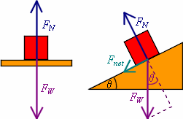
The Normal Force
The normal force is the perpendicular contact force that a surface exerts on another surface.
Use free body
diagrams to figure
out what is going on.

Slide 72
The Normal Force
The magnitude of the normal force is enough force to keep a system in equilibrium.
Adding weights example

Slide 73
Examples
What is the normal force on a box that is just sitting on a table?
$F_{N}=mg$
What is the normal force on the same box if I’m pulling up on it?
$F_{N}<mg$
What is the normal force on the same box if I am pushing down on it?
$F_{N}>mg$

Slide 74
More Examples
What is the normal force that the road exerts on a car that has a mass of 1,234kg?
$F_{N}=1,234kg\left(9.81\frac{m}{s^{2}}\right)=12,105.54N$
What is the normal force on a 2kg bottle that is touching a table but is being lifted with a 2N force at the same time?
$F_{N}=17.62N$
What is the normal force exerted by the floor on a 15kg desk if a 76kg student sits in it?
$F_{N}=$892.71N

Slide 75
Friction Force
Friction can come from a number of sources
Heat
Sound
Air resistance
Any kind of resistance
Any unwanted loss of energy

Slide 76
Types of Friction
Though friction can come from a variety of sources there are only two types of friction that we are going to work with.
Kinetic Friction
Static Friction

Slide 77
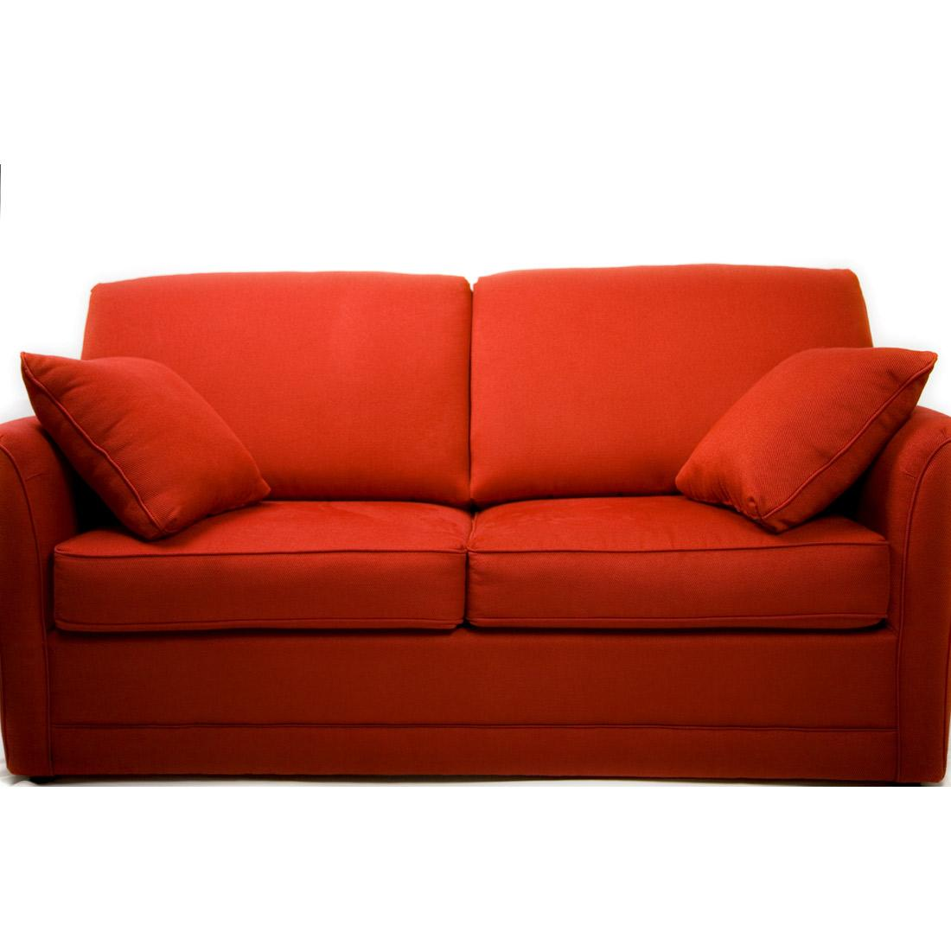
Kinetic Friction
Kinetic Friction
Is exerted on one surface by another when the two surfaces rub against each other because one or both surfaces are moving.
Moving Friction
Constant for two
specific objects

Slide 78
Static Friction
Static Friction
Is the frictional force exerted on one surface by another when there is no motion between the two surfaces/
Stationary Friction
Increases to a point then becomes kinetic friction

Slide 79
Friction Factors
What factors do you think will change the friction force between two objects?
Would this be important to an athletic footwear manufacturer?
BOOM! The labs never end!

Slide 80
Foot Friction
http://www.youtube.com/watch?v=cPpOxPlCTEs
http://www.youtube.com/watch?v=1gOcml84lt4
http://www.youtube.com/watch?v=ibxtmAVLaag

